Slide 1

Notes:
Reference: Pearson Edexcel Design & Technology, supplied reference PDF, section 1.10, printed pages 30–31. Topic: Thermoforming and thermosetting polymers. Slide artwork generated using sourced photographic references.
Thermosets degrade rather than melt after curing. Biodegradability depends on conditions and disposal infrastructure.

Slide 2
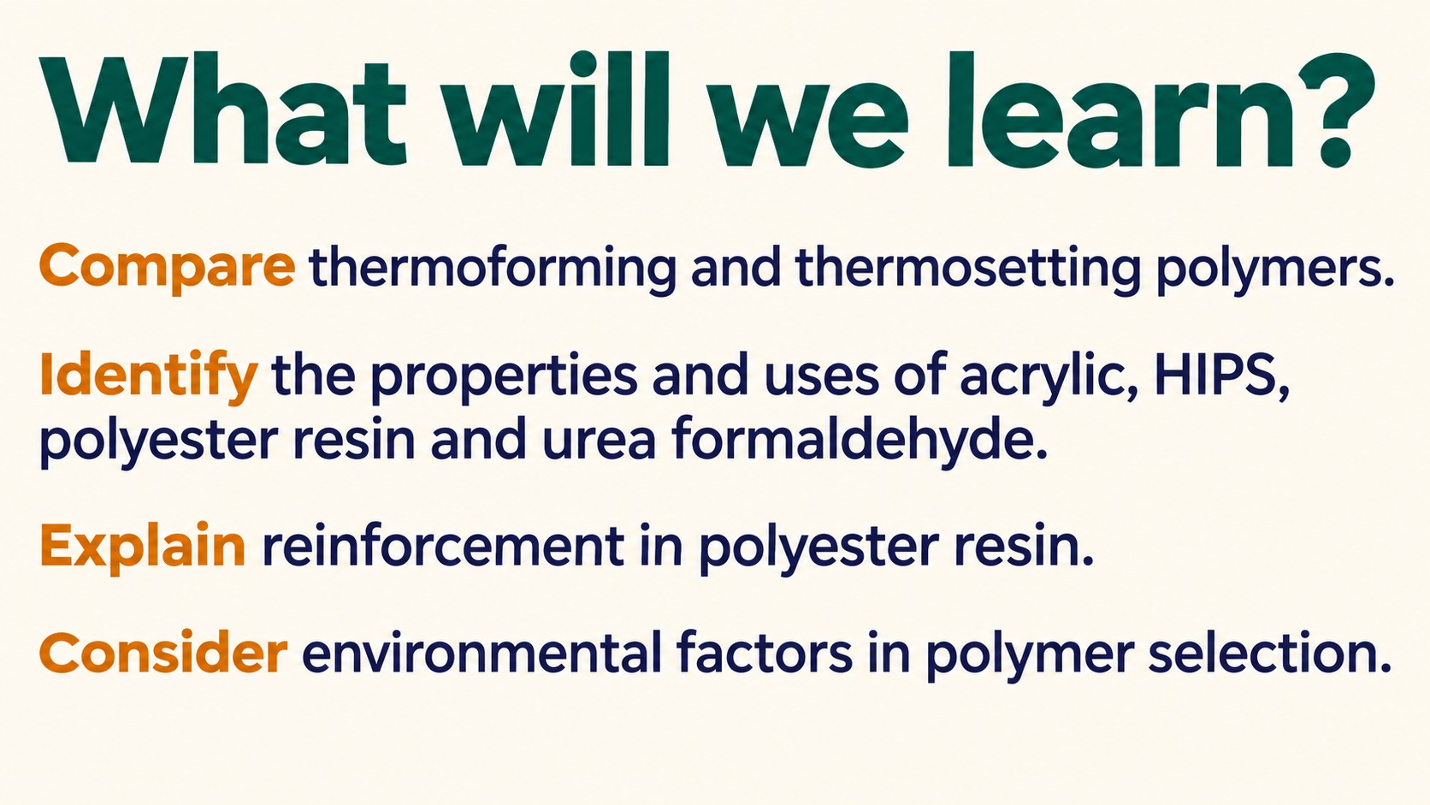
Notes:
Reference: Pearson Edexcel Design & Technology, supplied reference PDF, section 1.10, printed pages 30–31. Topic: Polymer materials learning goals. Slide artwork generated using sourced photographic references.
Thermosets degrade rather than melt after curing. Biodegradability depends on conditions and disposal infrastructure.

Slide 3

Notes:
Reference: Pearson Edexcel Design & Technology, supplied reference PDF, section 1.10, printed pages 30–31. Topic: Choosing materials for everyday products. Slide artwork generated using sourced photographic references.
Thermosets degrade rather than melt after curing. Biodegradability depends on conditions and disposal infrastructure.

Slide 4
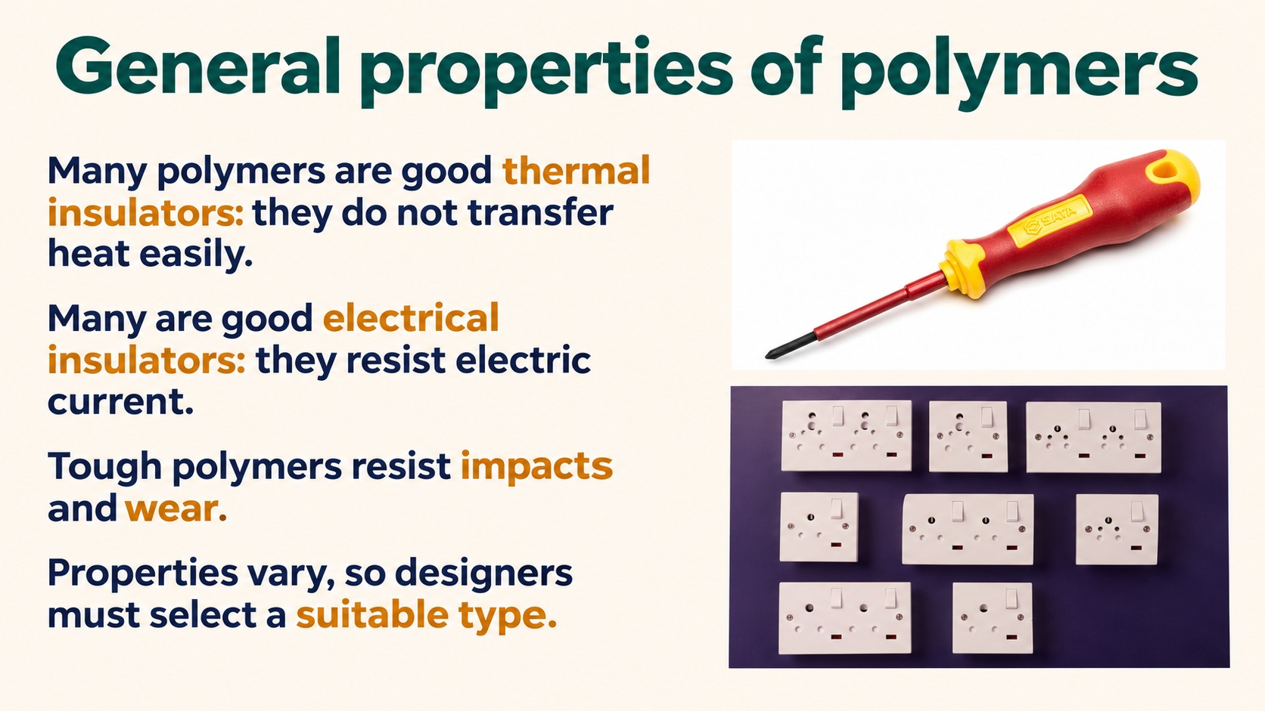
Notes:
Reference: Pearson Edexcel Design & Technology, supplied reference PDF, section 1.10, printed pages 30–31. Topic: General properties of polymers. Slide artwork generated using sourced photographic references.
Thermosets degrade rather than melt after curing. Biodegradability depends on conditions and disposal infrastructure.

Slide 5
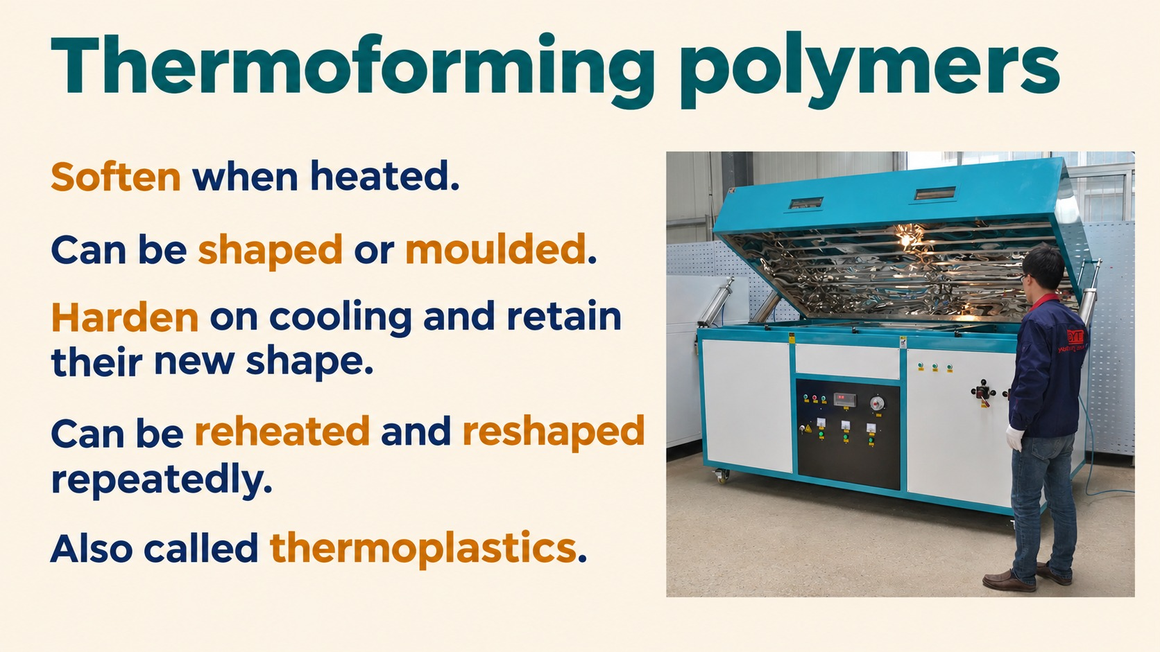
Notes:
Reference: Pearson Edexcel Design & Technology, supplied reference PDF, section 1.10, printed pages 30–31. Topic: Thermoforming polymers. Slide artwork generated using sourced photographic references.
Thermosets degrade rather than melt after curing. Biodegradability depends on conditions and disposal infrastructure.

Slide 6
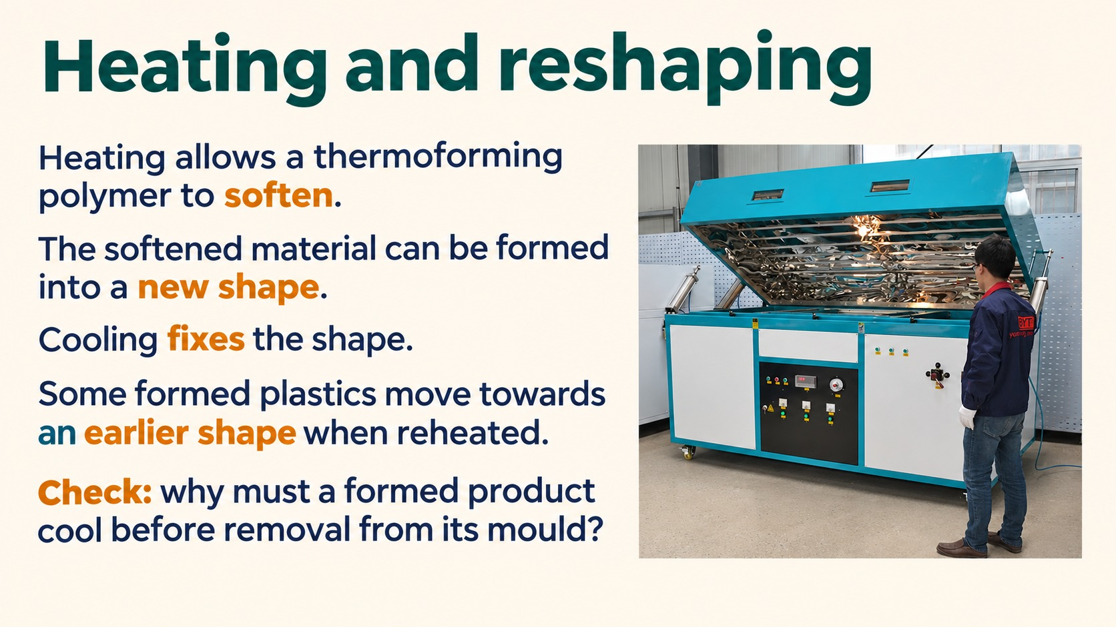
Notes:
Reference: Pearson Edexcel Design & Technology, supplied reference PDF, section 1.10, printed pages 30–31. Topic: Heating and reshaping(1). Slide artwork generated using sourced photographic references.
Thermosets degrade rather than melt after curing. Biodegradability depends on conditions and disposal infrastructure.

Slide 7

Notes:
Reference: Pearson Edexcel Design & Technology, supplied reference PDF, section 1.10, printed pages 30–31. Topic: Acrylic properties classroom overview. Slide artwork generated using sourced photographic references.
Thermosets degrade rather than melt after curing. Biodegradability depends on conditions and disposal infrastructure.

Slide 8

Notes:
Reference: Pearson Edexcel Design & Technology, supplied reference PDF, section 1.10, printed pages 30–31. Topic: Acrylic: uses and selection. Slide artwork generated using sourced photographic references.
Thermosets degrade rather than melt after curing. Biodegradability depends on conditions and disposal infrastructure.

Slide 9
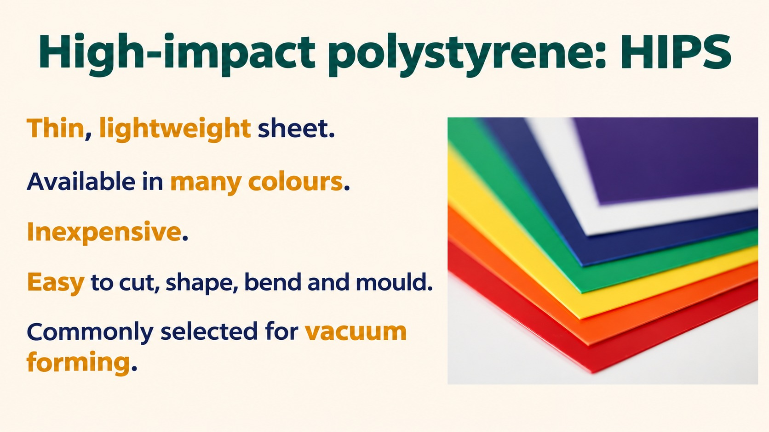
Notes:
Reference: Pearson Edexcel Design & Technology, supplied reference PDF, section 1.10, printed pages 30–31. Topic: High-impact polystyrene: HIPS. Slide artwork generated using sourced photographic references.
Thermosets degrade rather than melt after curing. Biodegradability depends on conditions and disposal infrastructure.

Slide 10
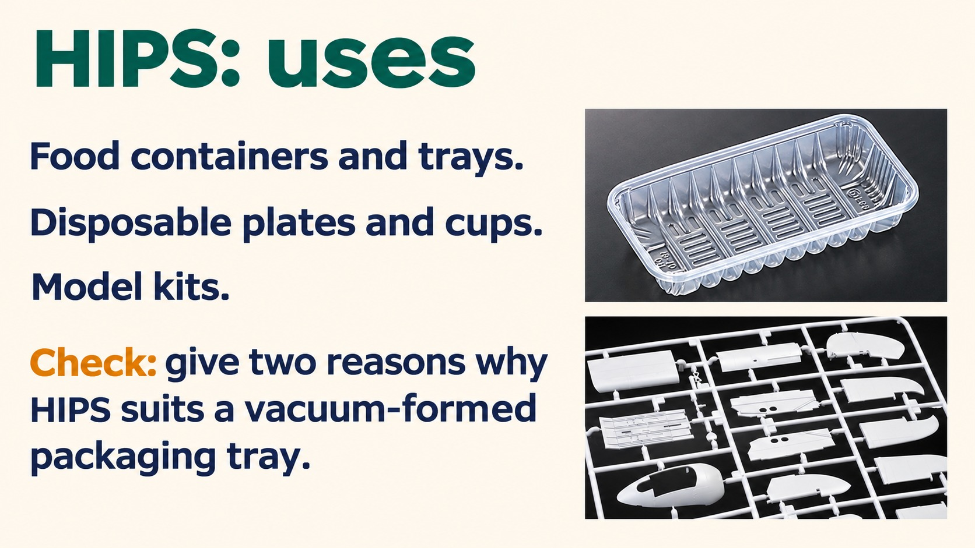
Notes:
Reference: Pearson Edexcel Design & Technology, supplied reference PDF, section 1.10, printed pages 30–31. Topic: HIPS uses: packaging and model kits. Slide artwork generated using sourced photographic references.
Thermosets degrade rather than melt after curing. Biodegradability depends on conditions and disposal infrastructure.

Slide 11
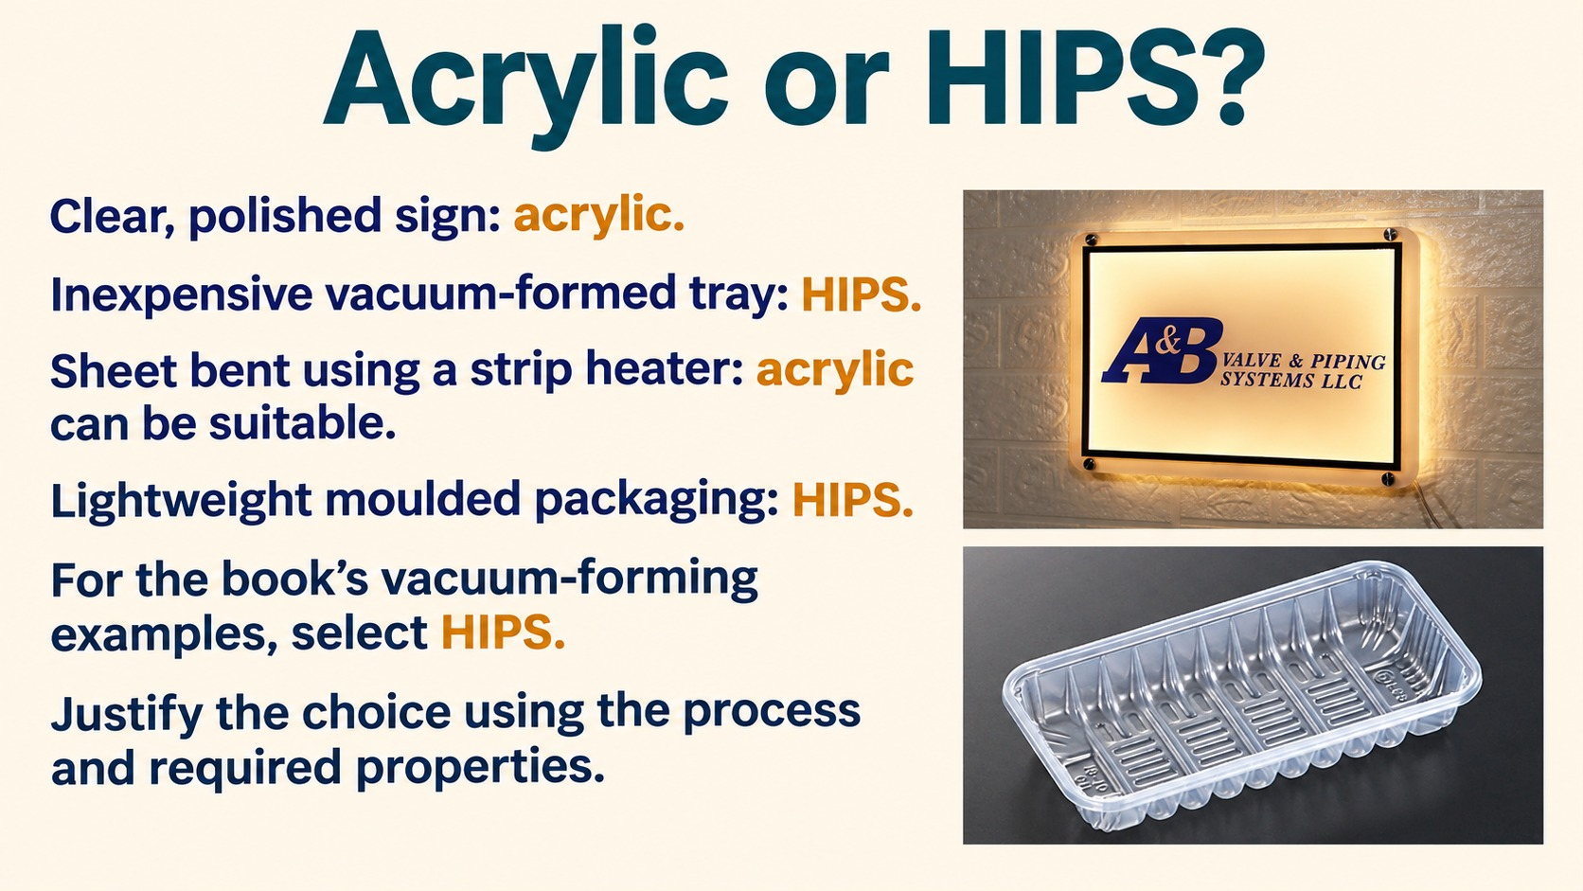
Notes:
Reference: Pearson Edexcel Design & Technology, supplied reference PDF, section 1.10, printed pages 30–31. Topic: Choosing acrylic or HIPS. Slide artwork generated using sourced photographic references.
Thermosets degrade rather than melt after curing. Biodegradability depends on conditions and disposal infrastructure.

Slide 12
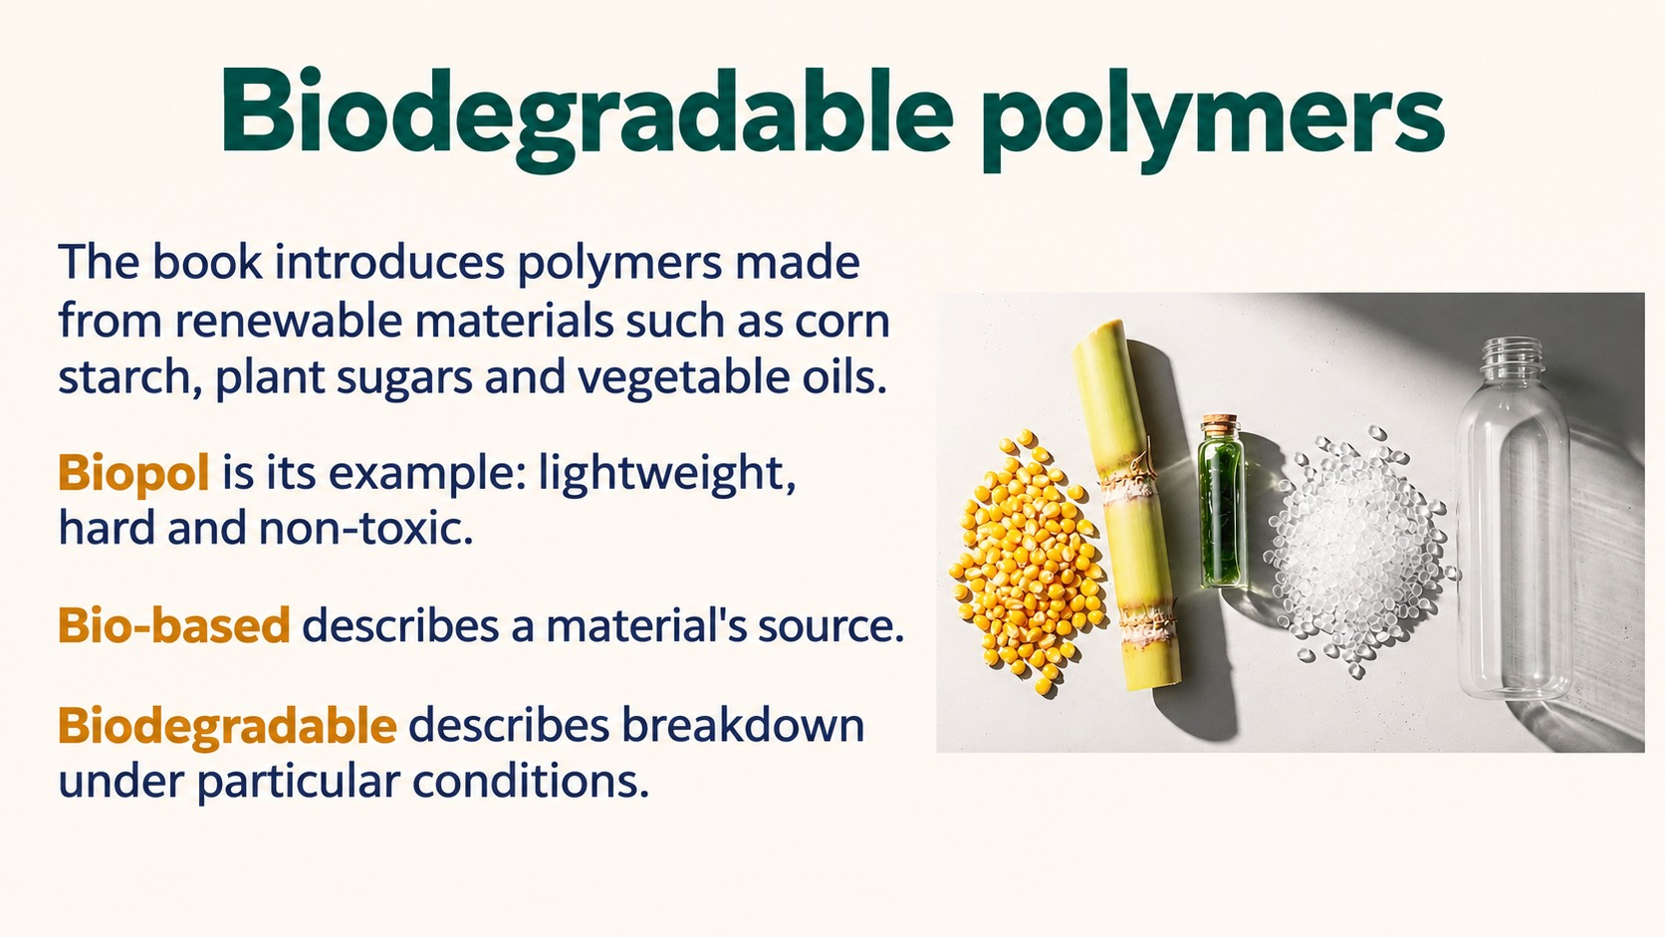
Notes:
Reference: Pearson Edexcel Design & Technology, supplied reference PDF, section 1.10, printed pages 30–31. Topic: Biodegradable polymers. Slide artwork generated using sourced photographic references.
Thermosets degrade rather than melt after curing. Biodegradability depends on conditions and disposal infrastructure.

Slide 13
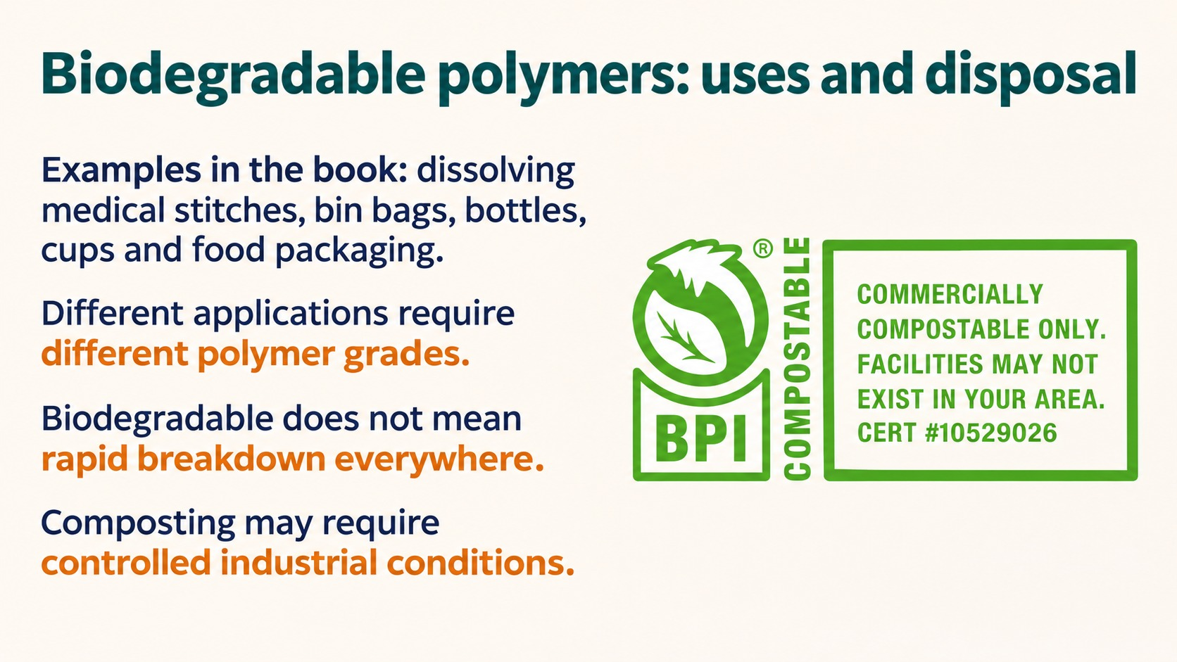
Notes:
Reference: Pearson Edexcel Design & Technology, supplied reference PDF, section 1.10, printed pages 30–31. Topic: Biodegradable polymers: uses and disposal. Slide artwork generated using sourced photographic references.
Thermosets degrade rather than melt after curing. Biodegradability depends on conditions and disposal infrastructure.

Slide 14
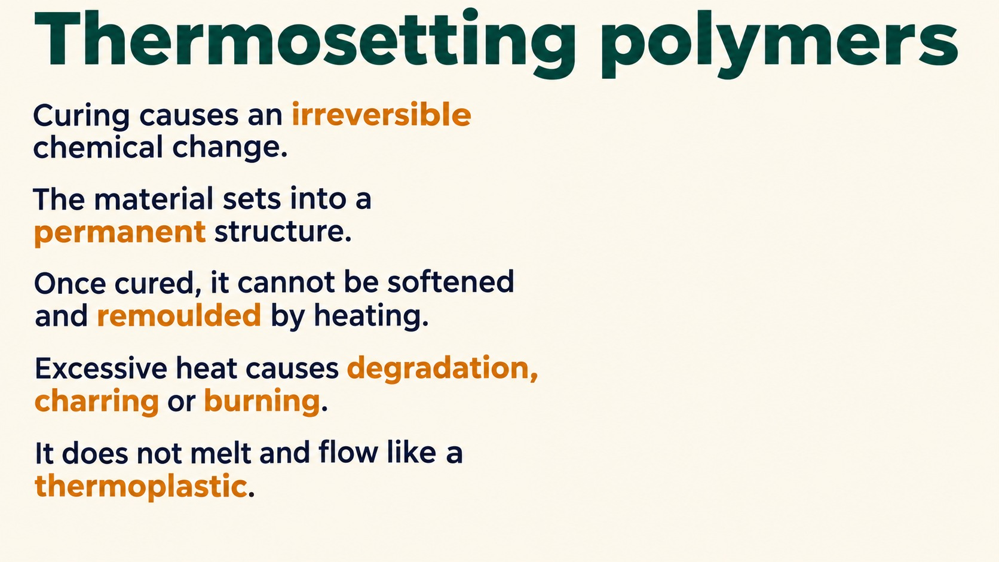
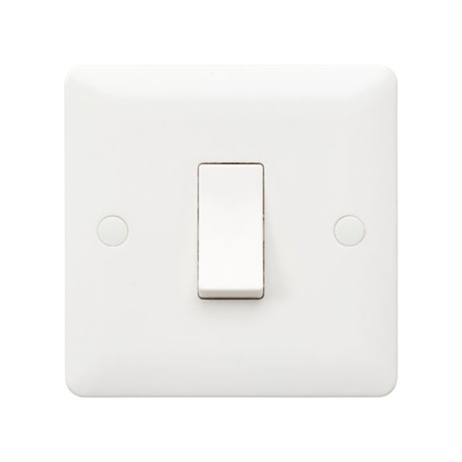
Notes:
Reference: Pearson Edexcel Design & Technology, supplied reference PDF, section 1.10, printed pages 30–31. Topic: Thermosetting polymers. Slide artwork generated using sourced photographic references.
Thermosets degrade rather than melt after curing. Biodegradability depends on conditions and disposal infrastructure.
Product photos: Honeywell MK switch, https://honeywell.scene7.com/is/image/Honeywell65/hbt-ep-mb4866whi-front and wood adhesive https://media.zid.store/85b20293-41ea-41ec-add8-31231865bddb/eac464be-c2d0-4682-b929-9daa80daad5d.png

Slide 15
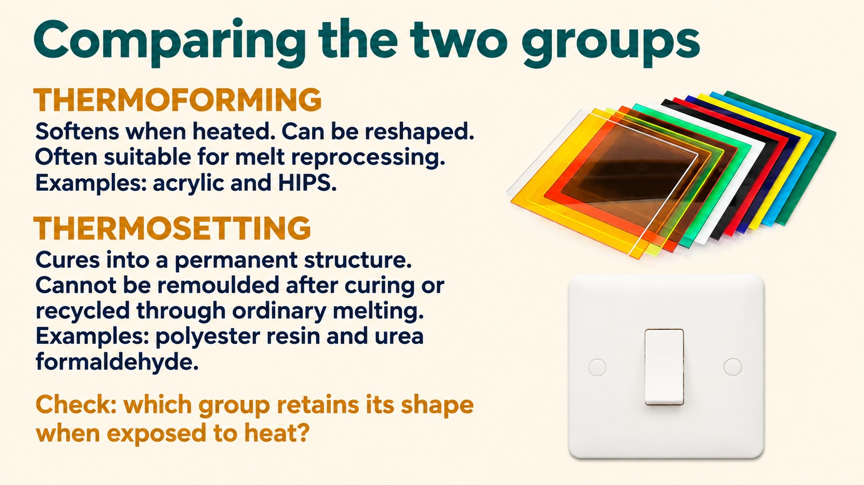
Notes:
Reference: Pearson Edexcel Design & Technology, supplied reference PDF, section 1.10, printed pages 30–31. Topic: Thermoforming vs. thermosetting. Slide artwork generated using sourced photographic references.
Thermosets degrade rather than melt after curing. Biodegradability depends on conditions and disposal infrastructure.

Slide 16
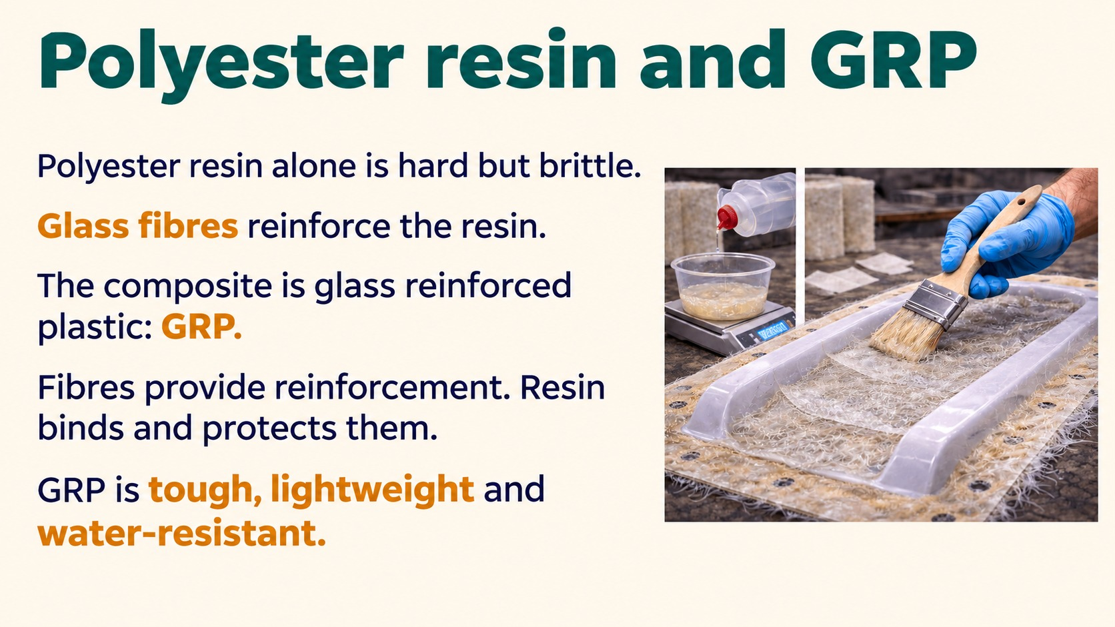
Notes:
Reference: Pearson Edexcel Design & Technology, supplied reference PDF, section 1.10, printed pages 30–31. Topic: Polyester resin and GRP. Slide artwork generated using sourced photographic references.
Thermosets degrade rather than melt after curing. Biodegradability depends on conditions and disposal infrastructure.

Slide 17

Notes:
Reference: Pearson Edexcel Design & Technology, supplied reference PDF, section 1.10, printed pages 30–31. Topic: GRP: properties and uses. Slide artwork generated using sourced photographic references.
Thermosets degrade rather than melt after curing. Biodegradability depends on conditions and disposal infrastructure.

Slide 18
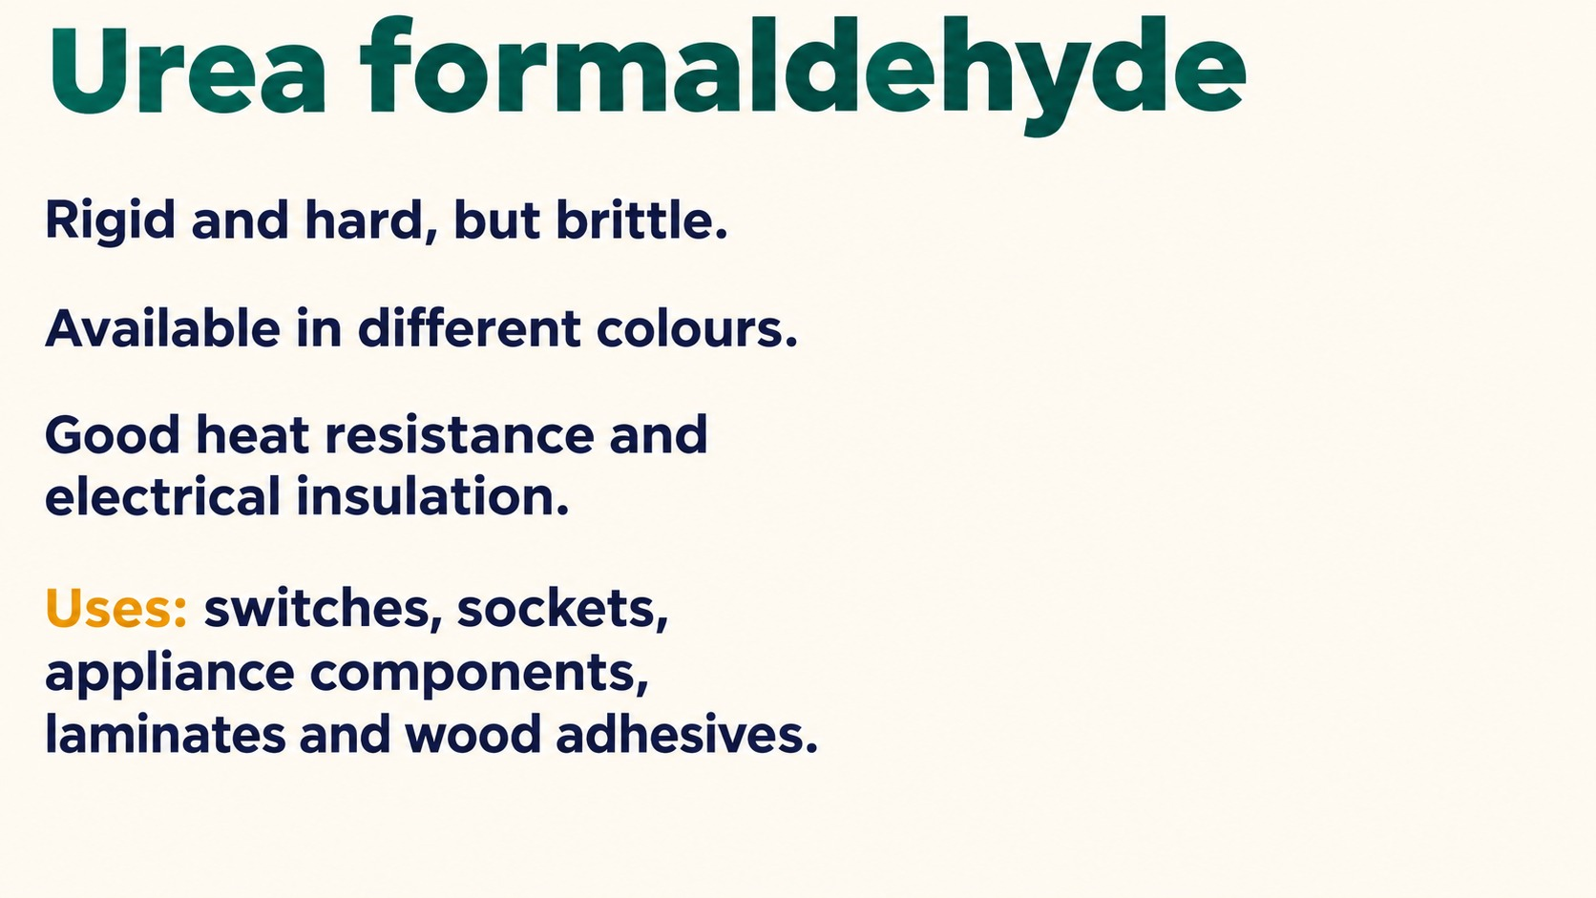
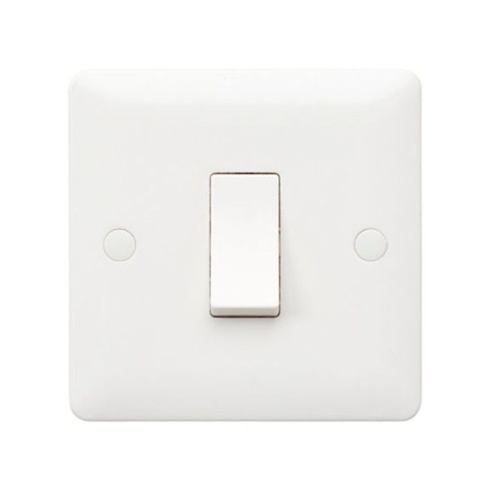
Notes:
Reference: Pearson Edexcel Design & Technology, supplied reference PDF, section 1.10, printed pages 30–31. Topic: Urea formaldehyde properties and uses(1). Slide artwork generated using sourced photographic references.
Thermosets degrade rather than melt after curing. Biodegradability depends on conditions and disposal infrastructure.
Product photos: Honeywell MK switch, https://honeywell.scene7.com/is/image/Honeywell65/hbt-ep-mb4866whi-front and wood adhesive https://media.zid.store/85b20293-41ea-41ec-add8-31231865bddb/eac464be-c2d0-4682-b929-9daa80daad5d.png

Slide 19
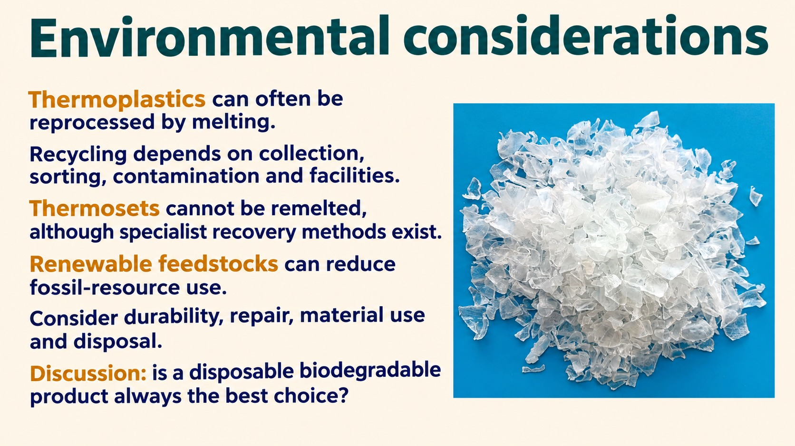
Notes:
Reference: Pearson Edexcel Design & Technology, supplied reference PDF, section 1.10, printed pages 30–31. Topic: Environmental considerations. Slide artwork generated using sourced photographic references.
Thermosets degrade rather than melt after curing. Biodegradability depends on conditions and disposal infrastructure.

Slide 20

Notes:
Reference: Pearson Edexcel Design & Technology, supplied reference PDF, section 1.10, printed pages 30–31. Topic: Polymer design challenge and exit ticket. Slide artwork generated using sourced photographic references.
Thermosets degrade rather than melt after curing. Biodegradability depends on conditions and disposal infrastructure.

